Slide 1
Chapter 15 : Concurrency Control

Slide 2
Chapter 15: Concurrency Control
Lock-Based Protocols
Timestamp-Based Protocols
Validation-Based Protocols
Multiple Granularity
Multiversion Schemes
Insert and Delete Operations
Concurrency in Index Structures

Slide 3
Lock-Based Protocols
A lock is a mechanism to control concurrent access to a data item
Data items can be locked in two modes :
1. exclusive (X) mode. Data item can be both read as well as
written. X-lock is requested using lock-X instruction.
2. shared (S) mode. Data item can only be read. S-lock is
requested using lock-S instruction.
Lock requests are made to concurrency-control manager. Transaction can proceed only after request is granted.

Slide 4
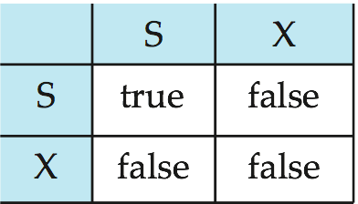
Lock-Based Protocols (Cont.)
Lock-compatibility matrix
A transaction may be granted a lock on an item if the requested lock is compatible with locks already held on the item by other transactions
Any number of transactions can hold shared locks on an item,
  but if any transaction holds an exclusive on the item no other transaction may hold any lock on the item.
If a lock cannot be granted, the requesting transaction is made to wait till all incompatible locks held by other transactions have been released. The lock is then granted.

Slide 5
Lock-Based Protocols (Cont.)
Example of a transaction performing locking:
T₂: lock-S(A);
read (A);
unlock(A);
lock-S(B);
read (B);
unlock(B);
display(A+B)
Locking as above is not sufficient to guarantee serializability — if A and B get updated in-between the read of A and B, the displayed sum would be wrong.
A locking protocol is a set of rules followed by all transactions while requesting and releasing locks. Locking protocols restrict the set of possible schedules.

Slide 6

Pitfalls of Lock-Based Protocols
Consider the partial schedule
Neither T₃ nor T₄ can make progress — executing lock-S(B) causes T₄ to wait for T₃ to release its lock on B, while executing lock-X(A) causes T₃ to wait for T₄ to release its lock on A.
Such a situation is called a deadlock.
  To handle a deadlock one of T₃ or T₄ must be rolled back
  and its locks released.

Slide 7
Pitfalls of Lock-Based Protocols (Cont.)
The potential for deadlock exists in most locking protocols. Deadlocks are a necessary evil.
Starvation is also possible if concurrency control manager is badly designed. For example:
  A transaction may be waiting for an X-lock on an item, while a sequence of other transactions request and are granted an S-lock on the same item.
  The same transaction is repeatedly rolled back due to deadlocks.
Concurrency control manager can be designed to prevent starvation.

Slide 8
The Two-Phase Locking Protocol
This is a protocol which ensures conflict-serializable schedules.
Phase 1: Growing Phase
  transaction may obtain locks
  transaction may not release locks
Phase 2: Shrinking Phase
  transaction may release locks
  transaction may not obtain locks
The protocol assures serializability. It can be proved that the transactions can be serialized in the order of their lock points (i.e. the point where a transaction acquired its final lock).

Slide 9
The Two-Phase Locking Protocol (Cont.)
Two-phase locking does not ensure freedom from deadlocks
Cascading roll-back is possible under two-phase locking. To avoid this, follow a modified protocol called strict two-phase locking. Here a transaction must hold all its exclusive locks till it commits/aborts.
Rigorous two-phase locking is even stricter: here all locks are held till commit/abort. In this protocol transactions can be serialized in the order in which they commit.

Slide 10
Quiz Time
Quiz Q1: Consuder the following locking schedule
T1
lock-X(A)
unlock-X(A)
lock-S(B)
unlock-S(B)
the schedule is two phase (2) the schedule is recoverable
(3) the schedule is cascade free (4) none of the above

Slide 11
Lock Conversions
Two-phase locking with lock conversions:
– First Phase:
  can acquire a lock-S on item
  can acquire a lock-X on item
  can convert a lock-S to a lock-X (upgrade)
– Second Phase:
  can release a lock-S
  can release a lock-X
  can convert a lock-X to a lock-S (downgrade)
This protocol assures serializability. But still relies on the programmer to insert the various locking instructions.

Slide 12
Automatic Acquisition of Locks
A transaction T_{i} issues the standard read/write instruction, without explicit locking calls.
The operation read(D) is processed as:
if T_{i} has a lock on D
then
read(D)
else begin
if necessary wait until no other
transaction has a lock-X on D
grant T_{i} a lock-S on D;
read(D)
end

Slide 13
Automatic Acquisition of Locks (Cont.)
write(D) is processed as:
if T_{i} has a lock-X on D
then
write(D)
else begin
if necessary wait until no other trans. has any lock on D,
if T_{i} has a lock-S on D
then
upgrade lock on D to lock-X
else
grant T_{i} a lock-X on D
write(D)
end;
All locks are released after commit or abort

Slide 14
Implementation of Locking
A lock manager can be implemented as a separate process to which transactions send lock and unlock requests
The lock manager replies to a lock request by sending a lock grant messages (or a message asking the transaction to roll back, in case of a deadlock)
The requesting transaction waits until its request is answered
The lock manager maintains a data-structure called a lock table to record granted locks and pending requests
The lock table is usually implemented as an in-memory hash table indexed on the name of the data item being locked

Slide 15
Deadlock Handling
System is deadlocked if there is a set of transactions such that every transaction in the set is waiting for another transaction in the set.
Deadlock prevention protocols ensure that the system will never enter into a deadlock state. Some prevention strategies :
  Require that each transaction locks all its data items before it begins execution (predeclaration).
  Impose partial ordering of all data items and require that a transaction can lock data items only in the order specified by the partial order (graph-based protocol).
  Deadlock prevention by ordering usually ensured by careful programming of transactions

Slide 16
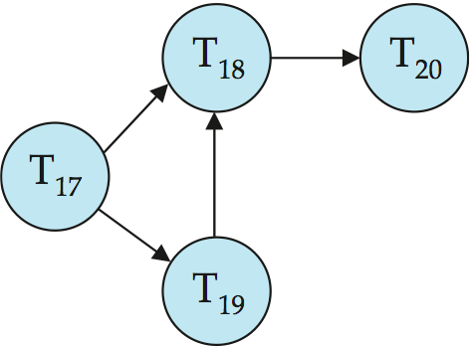
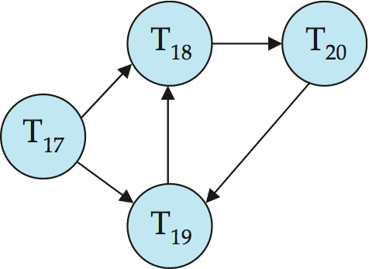
Deadlock Detection
Deadlock detection algorithms used to detect deadlocks
Wait-for graph without a cycle
Wait-for graph with a cycle

Slide 17
Deadlock Recovery
When deadlock is detected :
  Some transaction will have to rolled back (made a victim) to break deadlock. Select that transaction as victim that will incur minimum cost.
  Rollback -- determine how far to roll back transaction
    Total rollback: Abort the transaction and then restart it.
    More effective to roll back transaction only as far as necessary to break deadlock.
  Starvation happens if same transaction is always chosen as victim. Include the number of rollbacks in the cost factor to avoid starvation

Slide 18
Quiz Time
Quiz Q2: Consuder the following locking schedule
T1 T2
lock-S(A)
lock-S(B)
lock-X(B)
lock-A(B)
the schedule is not two phase (2) the schedule is deadlocked
(3) the schedule is not deadlocked (4) none of the above

Slide 19
Locking Extensions
Multiple granularity locking:
  idea: instead of getting separate locks on each record
    lock an entire page explicitly, implicitly locking all records in the page, or
    lock an entire relation, implicitly locking all records in the relation
  See book for details of multiple-granularity locking

Slide 20
Timestamp-Based Protocols
Each transaction is issued a timestamp when it enters the system. If an old transaction T_{i} has time-stamp TS(T_{i}), a new transaction T_{j} is assigned time-stamp TS(T_{j}) such that TS(T_{i}) <TS(T_{j}).
The protocol manages concurrent execution such that the time-stamps determine the serializability order.
In order to assure such behavior, the protocol maintains for each data Q two timestamp values:
  W-timestamp(Q) is the largest time-stamp of any transaction that executed write(Q) successfully.
  R-timestamp(Q) is the largest time-stamp of any transaction that executed read(Q) successfully.

Slide 21
Timestamp-Based Protocols (Cont.)
The timestamp ordering protocol ensures that any conflicting read and write operations are executed in timestamp order.
Suppose a transaction T_{i} issues a read(Q)
  If TS(T_{i}) ≤ W-timestamp(Q), then T_{i} needs to read a value of Q that was already overwritten.
    Hence, the read operation is rejected, and T_{i} is rolled back.
  If TS(T_{i})≥ W-timestamp(Q), then the read operation is executed, and R-timestamp(Q) is set to max(R-timestamp(Q), TS(T_{i})).

Slide 22
Timestamp-Based Protocols (Cont.)
Suppose that transaction T_{i} issues write(Q).
  If TS(T_{i}) < R-timestamp(Q), then the value of Q that T_{i} is producing was needed previously, and the system assumed that that value would never be produced.
    Hence, the write operation is rejected, and T_{i} is rolled back.
  If TS(T_{i}) < W-timestamp(Q), then T_{i} is attempting to write an obsolete value of Q.
    Hence, this write operation is rejected, and T_{i} is rolled back.
  Otherwise, the write operation is executed, and W-timestamp(Q) is set to TS(T_{i}).

Slide 23

Example Use of the Protocol
A partial schedule for several data items for transactions with
timestamps 1, 2, 3, 4, 5

Slide 24

Correctness of Timestamp-Ordering Protocol
The timestamp-ordering protocol guarantees serializability since all the arcs in the precedence graph are of the form:
Thus, there will be no cycles in the precedence graph
Timestamp protocol ensures freedom from deadlock as no transaction ever waits.
But the schedule may not be cascade-free, and may not even be recoverable.

Slide 25
Recoverability and Cascade Freedom
Problem with timestamp-ordering protocol:
  Suppose T_{i} aborts, but T_{j} has read a data item written by T_{i}
  Then T_{j} must abort; if T_{j} had been allowed to commit earlier, the schedule is not recoverable.
  Further, any transaction that has read a data item written by T_{j} must abort
  This can lead to cascading rollback --- that is, a chain of rollbacks
Solution 1:
  A transaction is structured such that its writes are all performed at the end of its processing
  All writes of a transaction form an atomic action; no transaction may execute while a transaction is being written
  A transaction that aborts is restarted with a new timestamp
Solution 2: Limited form of locking: wait for data to be committed before reading it
Solution 3: Use commit dependencies to ensure recoverability

Slide 26
Validation-Based Protocols
Execution of transaction T_{i} is done in three phases.
1. Read and execution phase: Transaction T_{i} writes only to
temporary local variables
2. Validation phase: Transaction T_{i} performs a ``validation test''
to determine if local variables can be written without violating
serializability.
3. Write phase: If T_{i} is validated, the updates are applied to the
database; otherwise, T_{i} is rolled back.
The three phases of concurrently executing transactions can be interleaved, but each transaction must go through the three phases in that order.
  Assume for simplicity that the validation and write phase occur together, atomically and serially
    I.e., only one transaction executes validation/write at a time.
Also called as optimistic concurrency control since transaction executes fully in the hope that all will go well during validation

Slide 27
Validation-Based Protocols (Cont.)
Validation is based on timestamps, but with two timestamps:
  start time
  validation time
Details in book

